Slide 1

Intro to Version Control
16 Jan 2017
Dr. Greg Erhardt
261 OHR 859-699-1761 greg.erhardt@uky.edu

Slide 2
Let’s get today’s lesson…

Slide 3
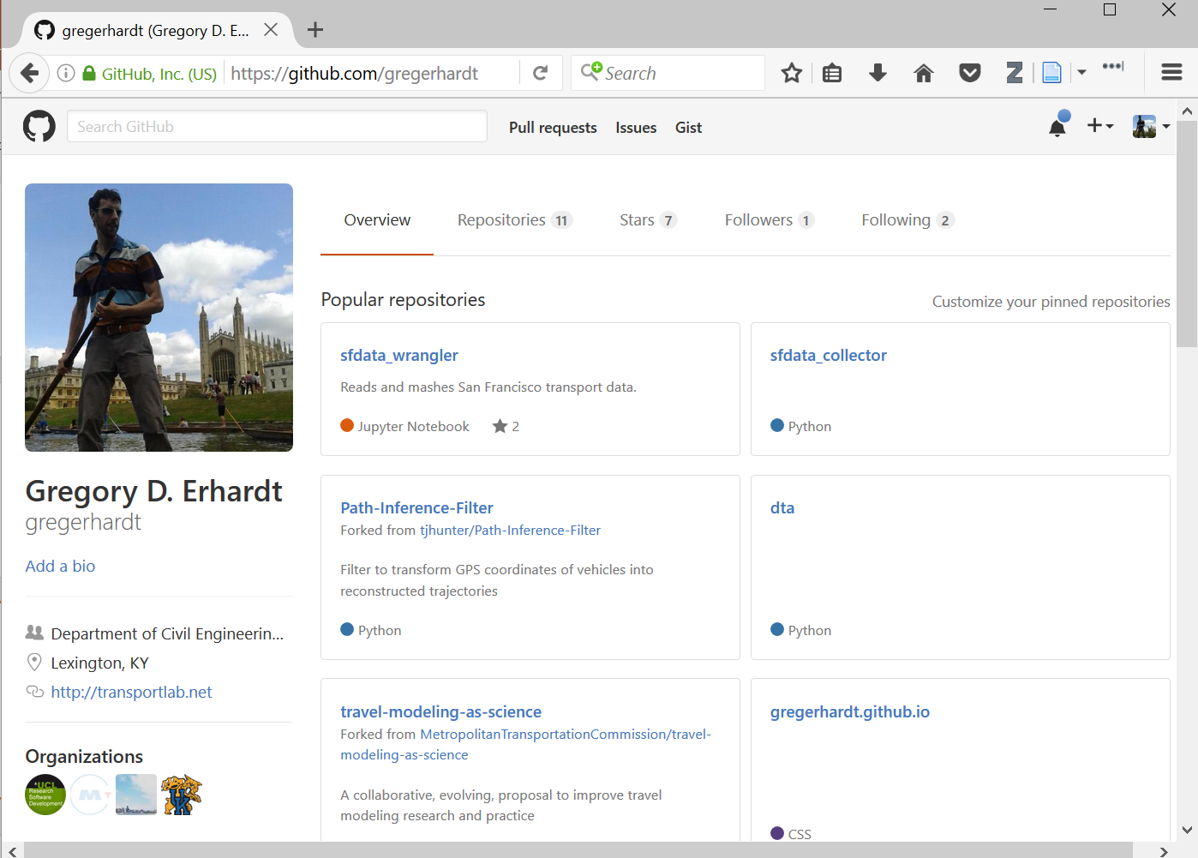
1. Go to github.com and log in.
2. Go to your account.
3. Accept my invitation.
4. Click on our organization.

Slide 4
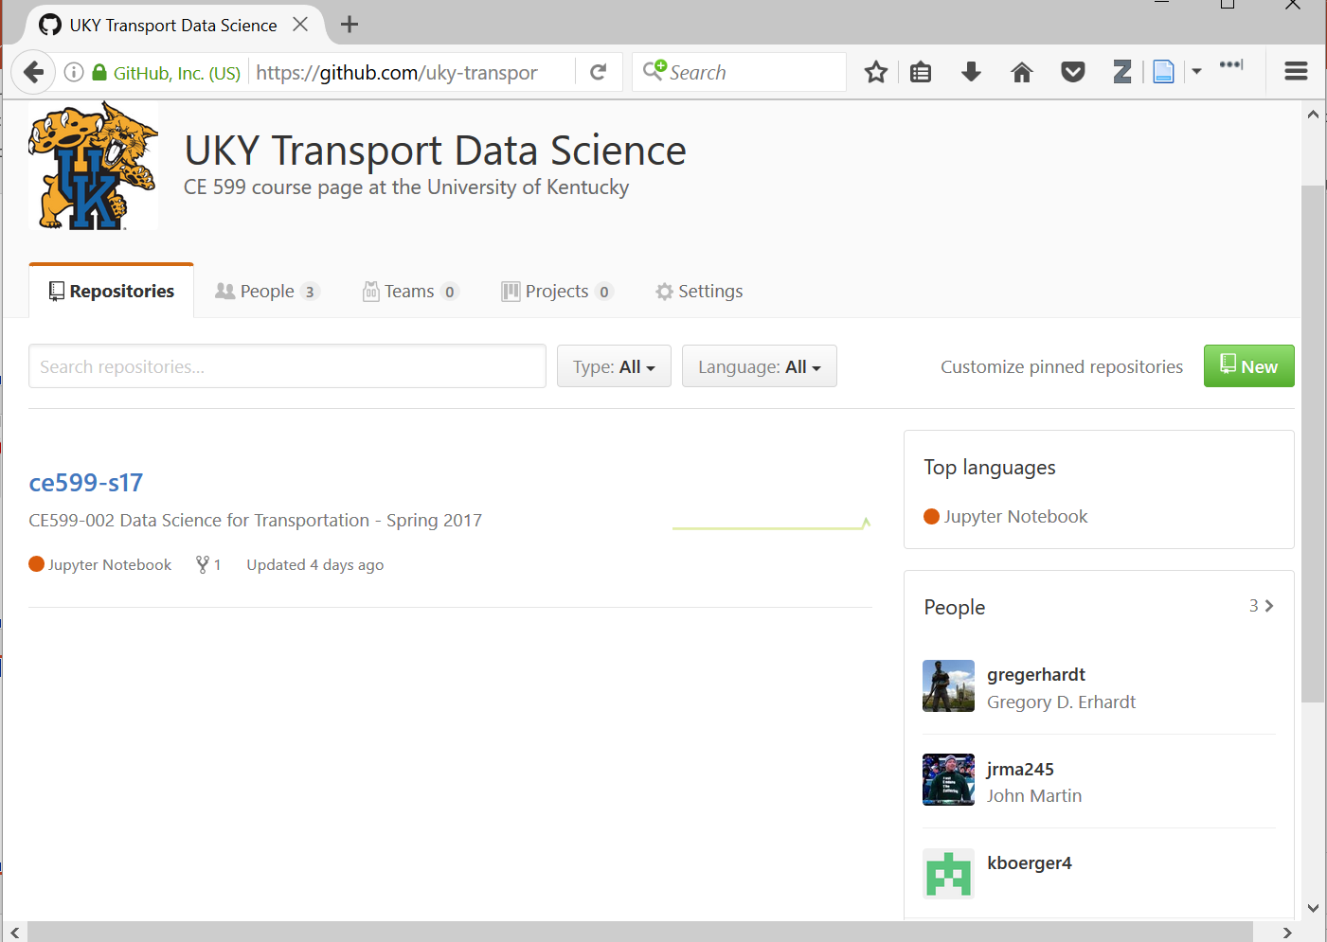
Let’s look at our class repository.

